Slide 1
FLEEKY HUB
PROJECT MANAGEMENT
PLAN
PROJMAN FINALS PRESENTATION

Slide 2
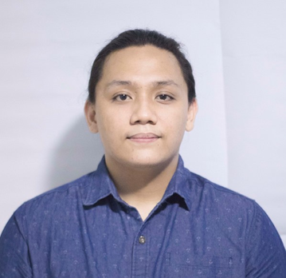
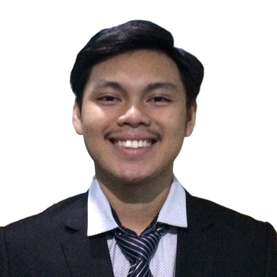

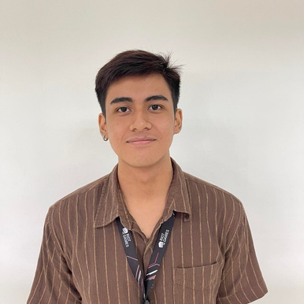
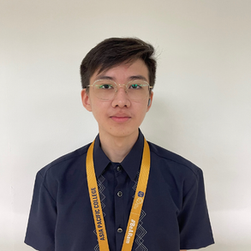
PALLAS FONTIVEROS
BRYAN FABELLORE
NEIL ALBERT GARCIA
JOSHUA
ROXAS
GABRIEL PEREZ
Group
Leader
Lead Developer
Project Manager
Project
Documentations
Project Documentations
NEIL
TRAN
Content
Department

Slide 3
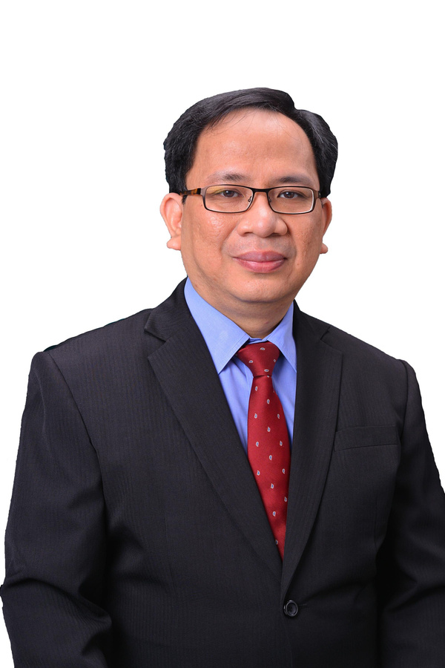
Project Adviser
GABRIEL PEREZ
EXECUTIVE DIRECTOR
TECHNICAL SERVICES DIRECTOR
ADMINISTRATIVE SUPPORT SERVICES
MR.
JOJO F.CASTILLO

Slide 4

INTRODUCTION
GABRIEL PEREZ
HAS A LIMITED NUMBER OF EMPLOYEES
RELIES ON SHOPEE'S SITE WHEN ORDERING A PRODUCT
EMPLOYEES MANUALLY RECORDS CUSTOMER INFORMATION AND TRANSACTIONS

Slide 5
PROBLEM STATEMENT
1
Delayed response in handling customer inquiries about the product
GABRIEL PEREZ
2
Staff have difficulties in catching up if there is a new or ongoing order.
3
Takes too long to manually record the transaction and customer information
4
Inconsistent recording of sales and transactions of customers

Slide 6
PROJECT
KEY DELIVERABLES
PALLAS
FONTIVEROS
User stories and acceptance criteria
Survey results and analysis
Inventory management system for products

Slide 7


PROJECT PURPOSE
TEAM GOAL
1
Generate higher yield or profit
Reach other markets
PROJECT PURPOSE
2
Automate the encoding process
Enable customers to make transaction directly with Fleeky Curtains
PLAN
3
Establish the website and its payment gateway active and be hosted in a domain.

Slide 8
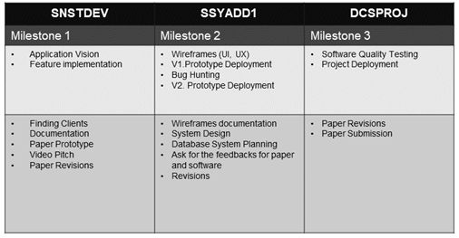
DELIVERABLES AND MILESTONES
PALLAS FONTIVEROS

Slide 9
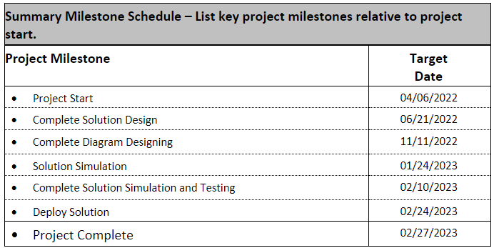
PALLAS FONTIVEROS
SUMMARY MILESTONE

Slide 10
KEY STAKEHOLDERS
Customers
PALLAS
FONTIVEROS
Employees
Suppliers/Partners

Slide 11
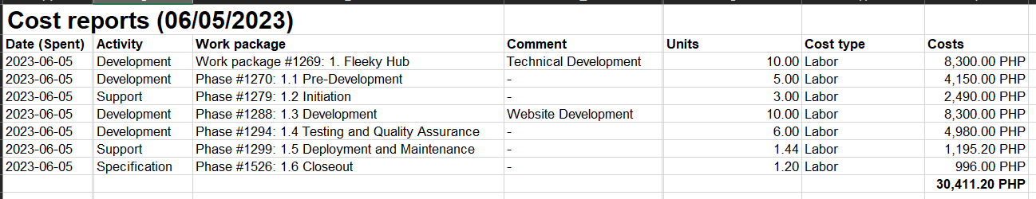
WORK BREAKDOWN STRUCTURE
LABOR
JOSHUA
ROXAS

Slide 12
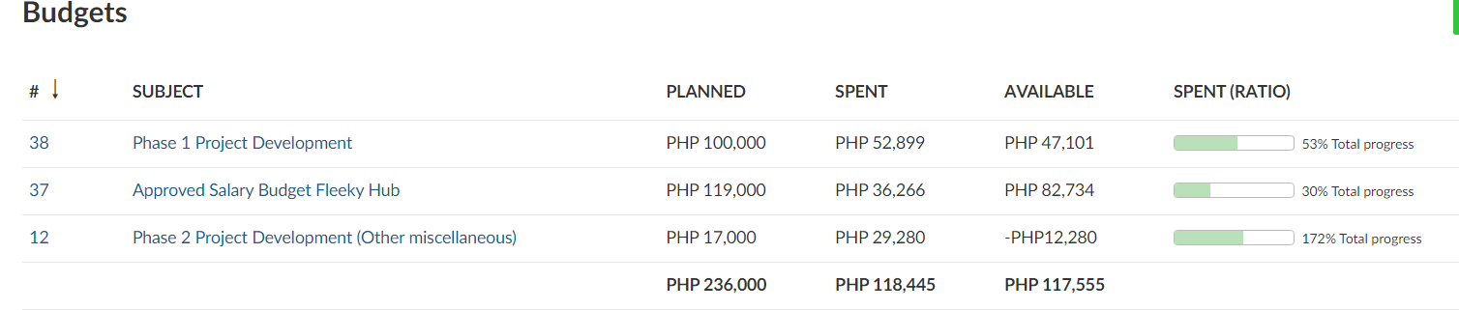
WORK BREAKDOWN STRUCTURE
JOSHUA
ROXAS

Slide 13
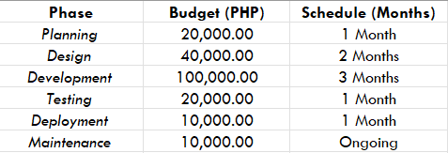
COST SCHEDULE SUMMARY
JOSHUA
ROXAS

Slide 14
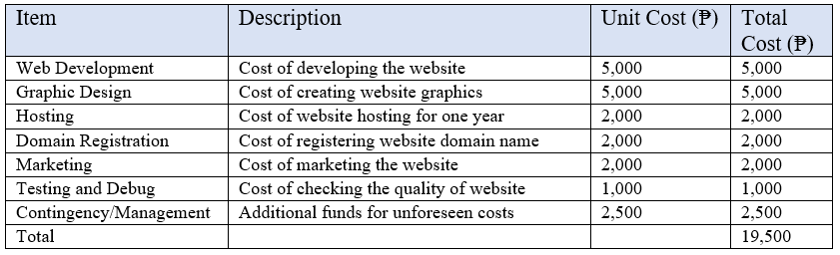
JOSHUA
ROXAS

Slide 15
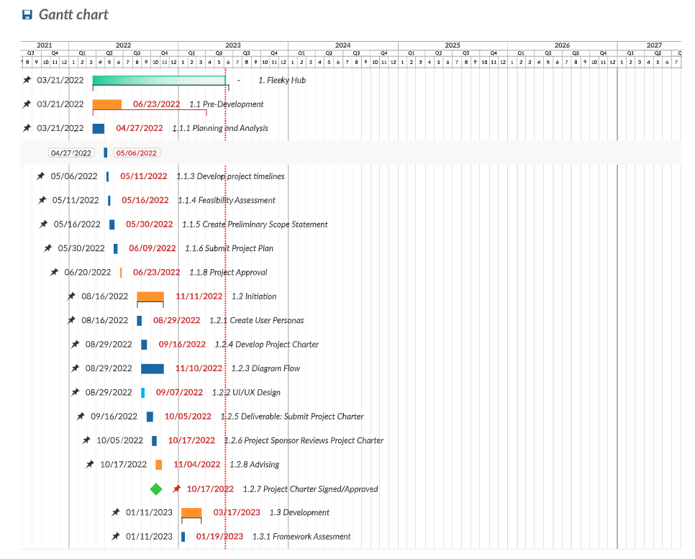
JOSHUA
ROXAS
SCHEDULE GANTT CHART SUMMARY

Slide 16
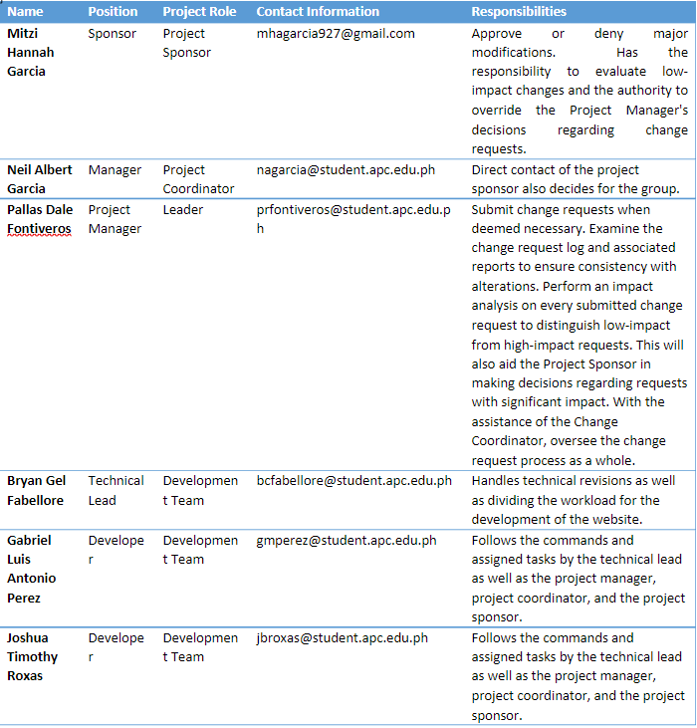
CHANGE CONTROL
BOARD
NEIL ALBERT GARCIA

Slide 17
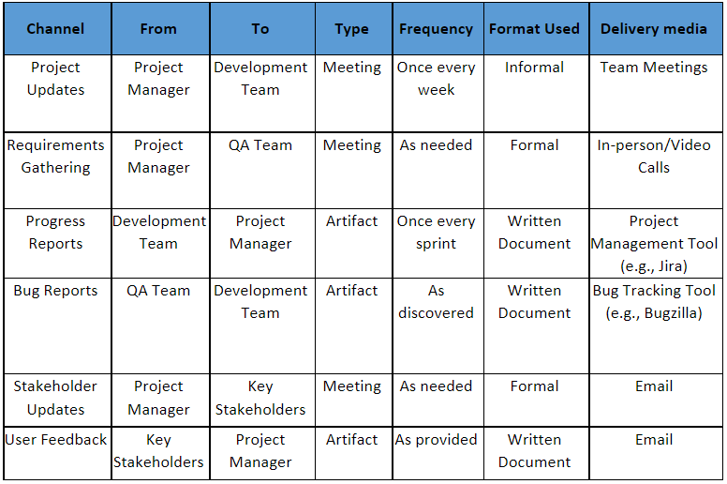
COMMUNICATION
MATRIX
NEIL ALBERT GARCIA

Slide 18
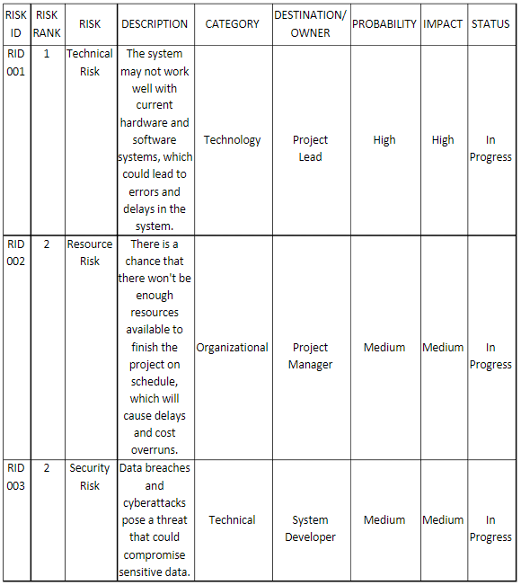
RISK
REGISTER
NEIL ALBERT GARCIA

Slide 19
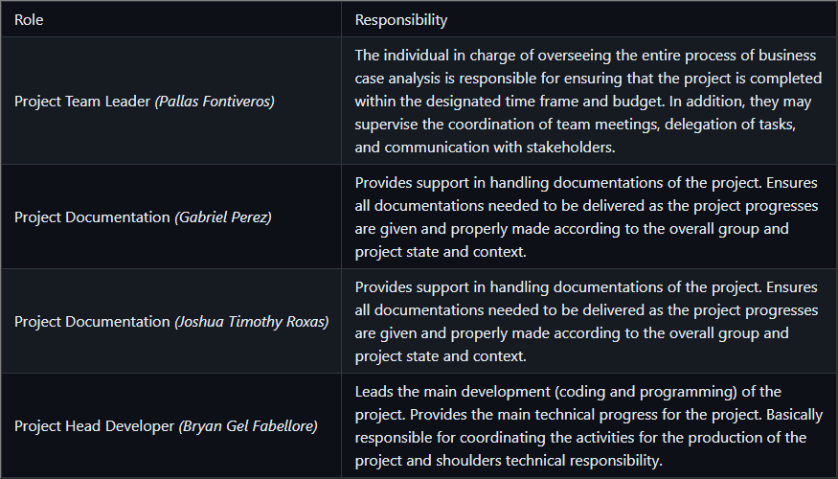
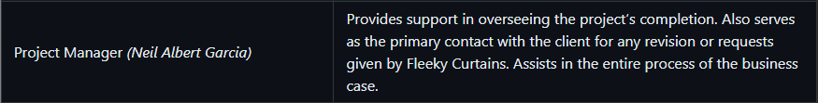
TRANSITION
APPROACH
BRYAN FABELLORE

Slide 20
PROJECT
OPEN
BRYAN FABELLORE

Slide 21
HUB
GIT
BRYAN FABELLORE

Slide 22
QUESTIONS?

